Slide 1
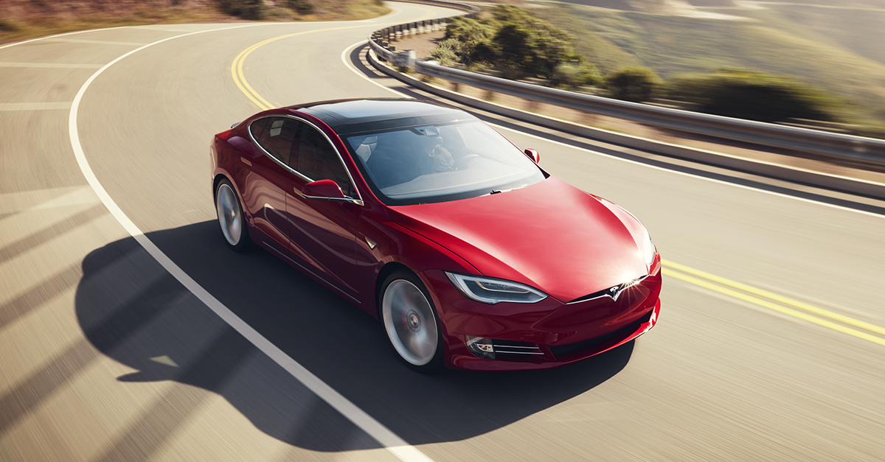
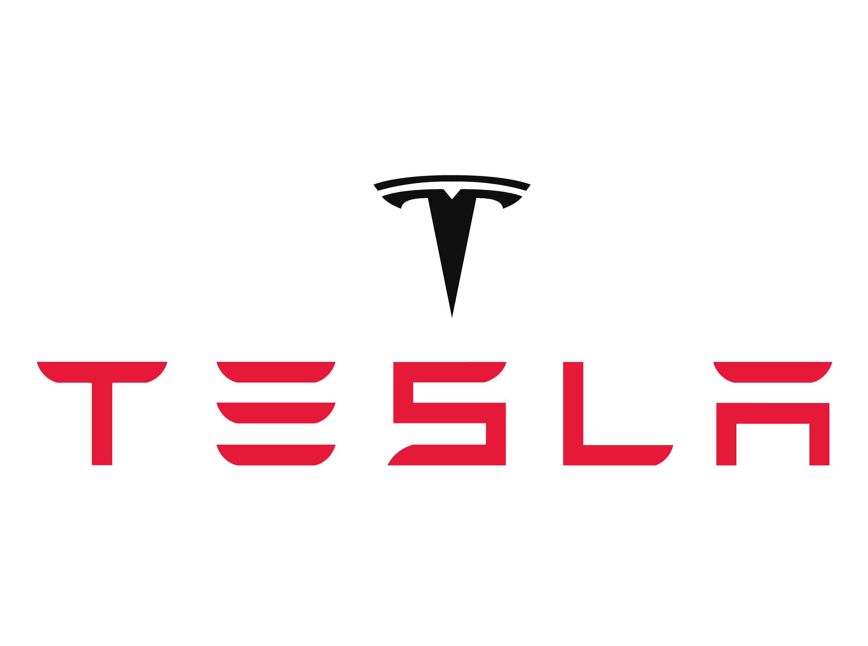
Artificial Intelligence and Machine Learning
Presenters: Clayton Kelly, Matthew Zlotnik, Shayaan Jagtap, Munish Umatiya

Slide 2
Introduction
Conclusion
Solutions
Areas of improvement
Strategic Issue
Background
Introduction
Background
Strategic Issue
Areas of Improvement
Solution
Conclusion
Notes:
Munish - no need to restate each one before stating the next

Slide 3
Methodology
Course concepts and Strategic Questions
What are Tesla’s winning aspirations?
Future Profitability?
How does AI play into this?
Tesla’s annual report
Examined credible sources
Introduction
Background
Strategic Issue
Areas of Improvement
Solution
Conclusion
Notes:
Munish

Slide 4
Background
Introduction
Background
Strategic Issue
Areas of Improvement
Solution
Conclusion
Notes:
Matthew

Slide 5
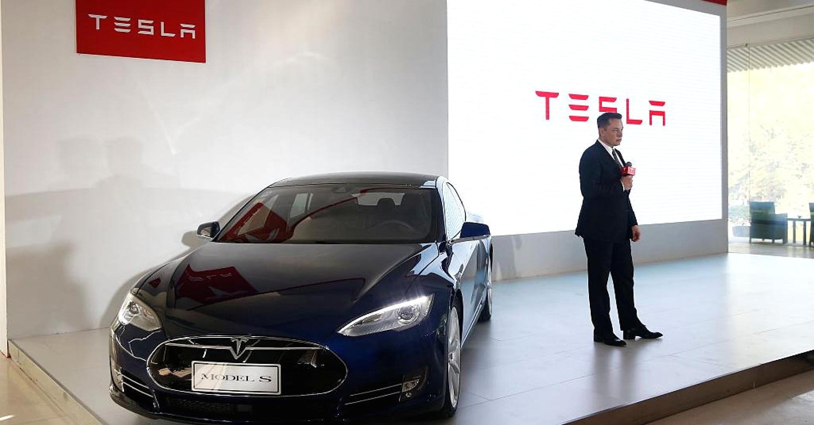
Company Background
Batteries, Cars, Solar Panels
2nd most innovative brand
Introduction
Background
Strategic Issue
Areas of Improvement
Solution
Conclusion
Notes:
Matthew

Slide 6
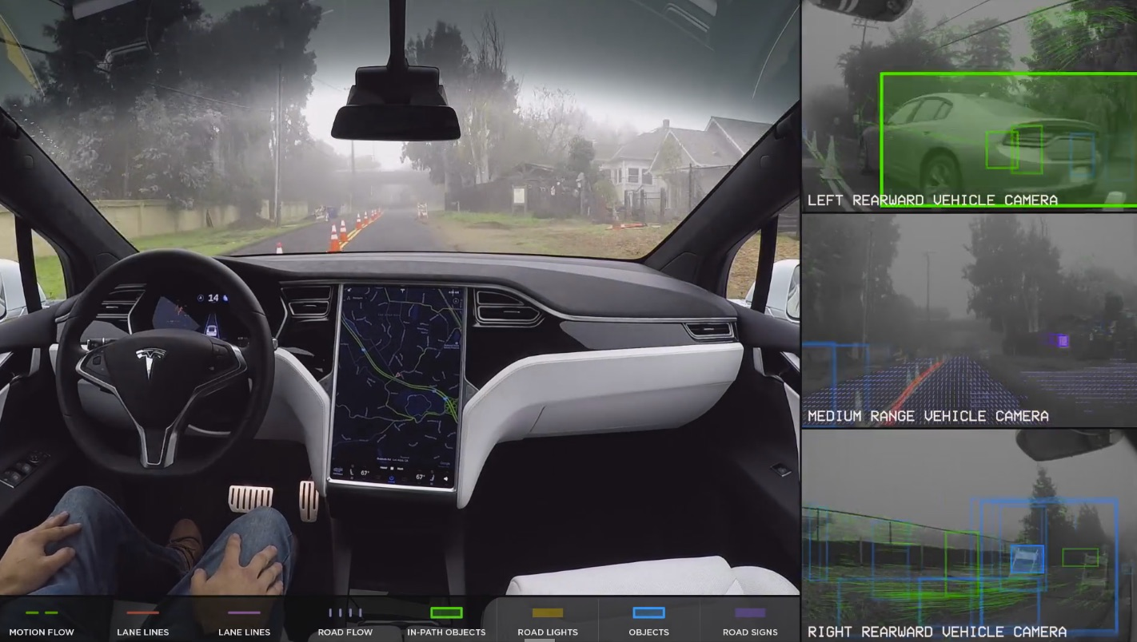
Company Background
AI AutoPilot
Deep learning
Disruption
Introduction
Background
Strategic Issue
Areas of Improvement
Solution
Conclusion
Notes:
Matthew

Slide 7
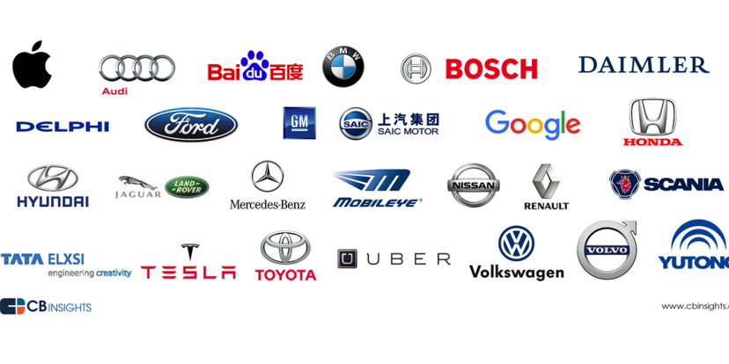
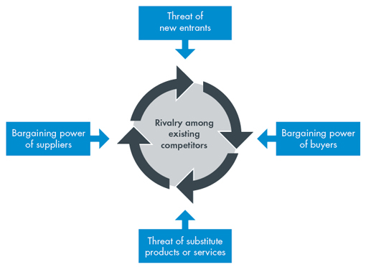
Company Background
Introduction
Background
Strategic Issue
Areas of Improvement
Solution
Conclusion
Notes:
Matthew

Slide 8
Strategic Issue
Introduction
Background
Strategic Issue
Areas of Improvement
Recommendations
Conclusion
Notes:
Munish

Slide 9
The Strategic Issue
$ PROFIT $
(...and lack thereof)
Introduction
Background
Strategic Issue
Areas of Improvement
Solution
Conclusion
Notes:
Munish

Slide 10
Areas of Improvement
Introduction
Background
Strategic Issue
Areas of Improvement
Solution
Conclusion
Notes:
Shayaan

Slide 11
Areas of Improvement
SG&A Reduction
Economies of Scale
R&D ROI
Introduction
Background
Strategic Issue
Areas of Improvement
Solution
Conclusion
Notes:
Shayaan

Slide 12
SG&A
1. Currently linear with Revenue should not be the case
2. Lack of granularity in financial statements
CUSTOMIZATION
Added production time
Added production costs
Introduction
Background
Strategic Issue
Areas of Improvement
Solution
Conclusion
Notes:
Shayaan

Slide 13
SG&A
Operational
efficiency!
Introduction
Background
Strategic Issue
Areas of Improvement
Solution
Conclusion
Notes:
Shayaan

Slide 14
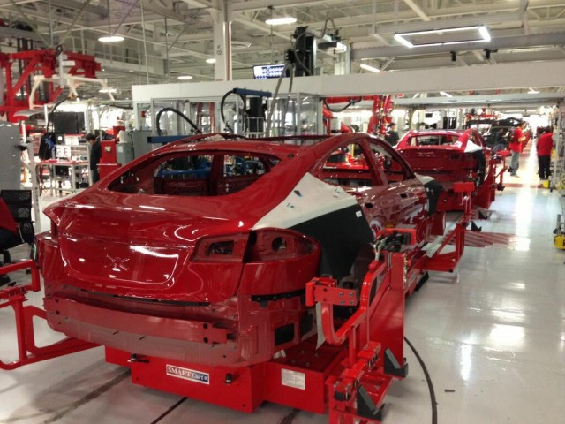
SG&A
Process and Capacity Design
Quality Management
Layout Design
Resource Scheduling
Inventory Management
Introduction
Background
Strategic Issue
Areas of Improvement
Solution
Conclusion
Notes:
Tesla hopes to boost productivity through increased automation, mainly by raising the machine to human ratio in the factory. The second area of improvement is quality management. By assuring more accurate quality metrics, Tesla will save on the number of personnel required to check, and eventually redo and replace sub-standard car parts. A third area is layout design and strategy. Optimizing this area will streamline processes and maximize utilization of equipment and facilities, and integrate advanced internal communication. A fourth area of improvement is resource scheduling, such as planning equipment usage as well as ordering in a timely manner ensure maximum slack for critical chain processes. This, coupled with a fifth point about inventory management, can ensure a consistent throughput of cars through each part of the process.

Slide 15
Economies of Scale
Exploiting economies of scale through efficient production
Batteries: $45,000 to ~$22,000 through the Gigafactory
Cost from $227/kWh to $125/kWh
45%
Introduction
Background
Strategic Issue
Areas of Improvement
Solution
Conclusion
Notes:
GF: 10m sqft, $5b

Slide 16
Research & Development
17.7% of Revenue
3x the second place spender
Not surprising for an Innovation leader
Physical
Car
Hardware
Information
Software
AI Platform
and
Introduction
Background
Strategic Issue
Areas of Improvement
Solution
Conclusion
Notes:
GF: 10m sqft, $5b

Slide 17
Research & Development
Physical
Problem:
Innovation leader status is expensive
Solution:
Nothing to change, as this is crucial
Focus on utilizing Information good
Information
Problem:
Currently no ROI - money sink
Solution:
Find a way to turn a profit to boost margins
Introduction
Background
Strategic Issue
Areas of Improvement
Solution
Conclusion
Notes:
GF: 10m sqft, $5b

Slide 18
Proposed solution
Introduction
Background
Strategic Issue
Areas of Improvement
Solution
Conclusion
Notes:
Clayton

Slide 19
Proposed Solution
“...sophisticated computer on wheels” - Musk
Advantage lies in their Technology
Split technology and physical product
Introduction
Background
Strategic Issue
Areas of Improvement
Solution
Conclusion
Notes:
Clayton

Slide 20
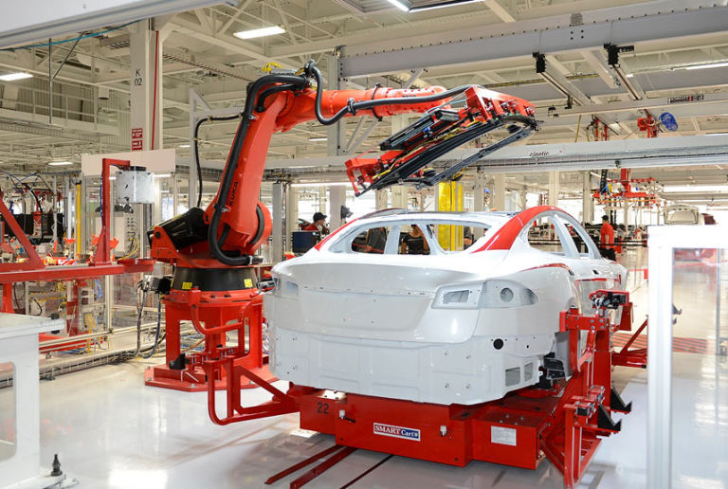
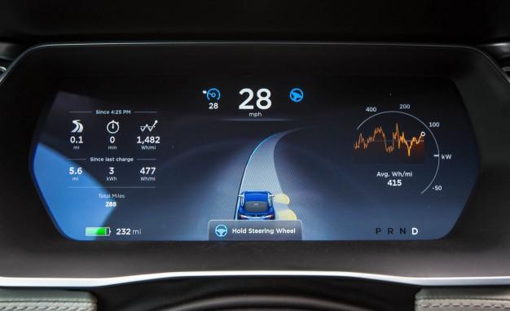
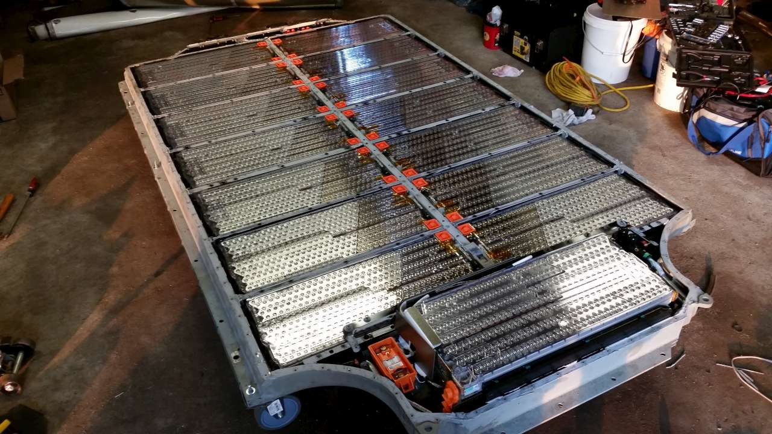
Company Assets
Vehicles
Batteries
Technology
Open Source Technology
Struggling Production
Affordability Issue
High-Risk Factory
Battery Competitors
High Manufacturing Capacity
Autopilot Competitors
Security
Potential Platform
Introduction
Background
Strategic Issue
Areas of Improvement
Solution
Conclusion
Notes:
Clayton

Slide 21
Solution
Freemium Product
Baseline Vehicle
Subscription-Based Applications
Offset potential Insurance costs
Constant cash flow to Tesla
Begin to build a Platform
Introduce a baseline model with limited digital features
Affordable
Upgradable
Introduction
Background
Strategic Issue
Areas of Improvement
Solution
Conclusion
Notes:
Clayton

Slide 22
Conclusion
Introduction
Background
Strategic Issue
Areas of Improvement
Solution
Conclusion
Notes:
Matthew

Slide 23
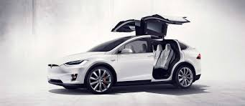
Conclusion
Offsetting Autopilot R&D costs through a monthly subscription fee
Reducing SG&A through efficient production
Taking advantage of economies of scale through the Gigafactory and increasing production volume
Introduction
Background
Strategic Issue
Areas of Improvement
Solution
Conclusion
Notes:
Matthew

Slide 24
Conclusion
Questions?
Notes:
Everyone

Slide 25
Artificial Intelligence and Machine Learning
Presenters: Clayton Kelly, Matthew Zlotnik, Shayaan Jagtap, Munish Umatiya

Slide 26
Sources
Bongdanov, Vik. “ WHAT IT'S LIKE TO BE A PRINCIPLE DATA ARCHITECT AT TESLA MOTORS” Intersog.com, 11 Apr. 2017, https://intersog.com/blog/software-teams/what-its-like-to-be-a-principle-data-architect-at-tesla-motors/
Brusewitz, Garrett. “Tesla: The Gigafactory Is The Key.”Seeking Alpha, 20 Jan. 2017, http://seekingalpha.com/article/4038307-tesla-gigafactory-key
Comendador, Alberto Zaragoza. “Tesla's SG&A Costs: Out Of Control.” Seeking Alpha, 13 Nov. 2017, http://seekingalpha.com/article/4124421-teslas-sg-costs-control
Davis, Scott. “Tesla, Tesla, Tesla: Building A Power Brand From Scratch.” Forbes, Forbes Magazine, 24 Feb. 2014, www.forbes.com/sites/scottdavis/2014/02/24/tesla-tesla-tesla-building-a-power-brand-from-scratch/#90237527e315.
DeBord, Matthew. “Elon Musk is setting himself up for an epic failure” businessinsider.com, 7 May. 2016, http://www.businessinsider.com/musk-epic-failure-2016-5
DeBord, Matthew. “Elon Musk just made a totally mind-blowing change to Tesla's strategy” businessinsider.com, 7 May. 2016, http://www.businessinsider.com/tesla-mind-blowing-change-strategy-2016-5
Eady, Trent. “Tesla Leapfrogs Self-Driving Competitors With Radar That's Better Than Lidar” seekingalpha.com, 9 May. 2017, https://seekingalpha.com/article/4071192-tesla-leapfrogs-self-driving-competitors-radar-better-lidar
Halla, Brian. ”Piecing Together the Tesla Strategy Puzzle” HBR.org, 16 Sept. 2015, https://hbr.org/2015/09/piecing-together-the-tesla-strategy-puzzle
Hu, Charlotte, et al. “Tesla Autopilot and Artificial Intelligence: The Unfair Advantage.“ TESLARATI.com, 6 July 2017 www.teslarati.com/tesla-autopilot-ai-artificial-intelligence-unfair-advantage/
Ingraham, Christopher. “The astonishing human potential wasted on commutes” washintonpost.com, 26 Feb. 2016, https://www.washingtonpost.com/news/wonk/wp/2016/02/25/how-much-of-your-life-youre-wasting-on-your-commute/?utm_term=.187329819f93
Lambert, Fred. “Tesla Is Now Claiming 35% Battery Cost Reduction at ‘Gigafactory 1’ – Hinting at Breakthrough Cost below $125/KWh.” Electrek, 18 Feb. 2017, https://electrek.co/2017/02/18/tesla-battery-cost-gigafactory-model-3/.
Musk, Elon. “All Our Patent Are Belong To You” tesla.com, 12 Jun. 2014, https://www.tesla.com/blog/all-our-patent-are-belong-you
Pressman, Matt. “Culture of Innovation: Tesla Has Triple the R&D of Traditional Automakers [Infographic].” Evanex, 4 Nov. 2016, https://evannex.com/blogs/news/innovation-culture-tesla-r-d-spending-versus-other-automakers.
Ryan, Kevin J. “Tesla Explains How A.I. Is Making Its Self-Driving Cars Smarter.” Inc.com, Inc., 13 Sept. 2016, www.inc.com/kevin-j-ryan/how-tesla-is-using-ai-to-make-self-driving-cars-smarter.html.
Thompson, Andrew. “Tesla Motors, Inc.'s Operations Management: 10 Decisions, Productivity.” Panmore Institute, 21 Feb. 2017, https://panmore.com/tesla-motors-inc-operations-management-10-decisions-areas-productivity
Wolters, Vincent. “Tesla: A Closer Look At Margins And Profitability.”Seeking Alpha, 23 May 2017, http://seekingalpha.com/article/4075701-tesla-closer-look-margins-profitability
“Autopilot.” Tesla, Inc, www.tesla.com/autopilot.
“The World's Most Innovative Companies” Forbes, Forbes Magazine, www.forbes.com/innovative-companies/#367d8f1a1d65
Mercedes Drive Pilot Technology https://www.theverge.com/ces/2017/1/6/14177872/mercedes-benz-drive-pilot-self-driving-tesla-autopilot-ces-2017
Forbes Top Selling Cars In World https://www.forbes.com/pictures/mkk45ekfi/1-toyotacorolla-201112/#51b826b834e1
Biggest Cost of Model 3 https://www.investopedia.com/articles/personal-finance/032415/why-are-tesla-cars-so-expensive.asp
Production of Model 3 https://electrek.co/2017/11/09/tesla-model-3-production-numbers/
Why Model 3 is so Cheap https://www.inverse.com/article/30244-why-is-the-tesla-model-3-so-cheap

